Slide 1

DEPARTMENT OF COMPUTER SCIENCE AND ENGINEERING
ACS COLLEGE OF ENGINEERING
KAMBIPURA, MYSORE ROAD, BANGLORE-74
8th Sem Project Review on:
CERTIFICATE VALIDATION USING BLOCKCHAIN
Presented By: Vishal Prasad Sharma 1AH21CS123 Anayat Altaf Shah 1AH21CS127 Raj Kumar 1AH21CS081
Vandan Kumar M 1AH21CS117

Slide 2
INTRODUCTION
Blockchain ensures trust and security – It uses cryptographic principles to provide immutability and tamper resistance, making it ideal for certificate verification.
Addresses forgery and inefficiencies – Traditional systems are slow, centralized, and prone to manipulation or errors.
Motivation – The rise in fake certificates and manual validation difficulties inspired us to design a decentralized verification model.

Slide 3
LITERATURE SURVEY
SURVEY | AUTHOR | YEAR | EXPLANATION
SURVEY 1: Blockchain and smart contract for digital certificate | Jiin-chiou etal.,, | 2024 | generate the electronic file and calculate hash value for it. system creates a QR-code Pros : certificate granting are open and transparent in the system. Cons : QR-code must be scanned with smartphone and internet connection is required.
SURVEY 2: Blockchain based certificate transparency and revocation | Zewang Jingqiang Lin etal.,, | 2023 | CAs signed certificates and their revocation status information of an SSL/TLS web server are published by the subject and append it to the global certificate blockchain . Blockchain act as public logs to monitor CAs certificate signing and revocation operations Pros: Avoids the certificate fraudulent Cons: : Certificate validation delay and false sense of security
Survey 3: Certificate transparency using blockchain | Dsv madala etal.,,, | 2022 | Hyperledger fabric is used. CTB smart contract. Pros : logs-consistency Cons: low scalability and less transaction

Slide 4
OBJECTIVE
Develop a secure certificate verification system – Certificates are hashed and linked to a blockchain to prevent tampering.
Allow instant public verification – Anyone with a QR scanner can verify authenticity without needing to contact the issuing authority.
Enhance transparency and trust – Decentralization removes the need for a middleman or central database.

Slide 5
PROBLEM STATEMENT
Forgery is hard to detect manually – Even skilled fake certificates can go undetected without a technical verification system.
Traditional methods are slow and not scalable – Institutions verify credentials manually, which delays hiring, admissions, and cross-verifications.
Need for a decentralized system – A blockchain-based solution provides tamper-proof, quick verification with minimal human intervention

Slide 6
SYSTEM REQUIREMENTS
Hardware – At least an Intel i3 processor and 4GB RAM to ensure smooth GUI and blockchain operations.
Software – Python 3.9, PyQt5 for GUI, hashlib for hashing, and QRCode for QR code generation.

Slide 7
Existing System
Manual verification is time-consuming – It involves emailing certificates to institutions and waiting for confirmation.
Hyperledger-based systems are limited – Mostly used in B2B with less scalability and not suitable for public verification.
Lack of public, transparent solutions – Centralized systems are opaque, with high chances of data manipulation.

Slide 8
PROPOSED SYTEM
Blockchain records certificate hashes – Certificate data is hashed using SHA-256 and added to a block with previous hash linkage.
QR codes for instant access – Each certificate gets a unique QR code representing its hash, allowing quick and simple verification.
Tamper detection – If the certificate is modified, its hash changes and does not match the blockchain record, exposing tampering.

Slide 9
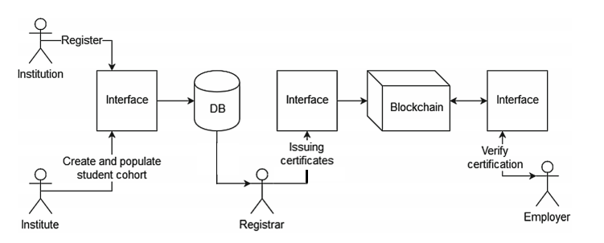
PROPOSED SYSTEM ARCHITECTURE

Slide 10
SUB MODULES
Preprocessing Module – Takes certificate details (name, degree, year, etc.), validates them, and prepares for hashing.
Feature Extraction / Hashing – Generates SHA-256 hash for each certificate; this hash becomes its unique identity.
QR Code & Verification – Encodes hash into QR code; during verification, the scanned hash is matched with blockchain entries.

Slide 11
Data Flow Diagrams (DFD)
Level 0 – User interacts with the app to register or verify; app communicates with blockchain to store or retrieve hashes.
Level 1 – Details steps for issuing and verifying certificates, including generating hash and QR code, scanning, and validation.
Level 2 – Shows low-level steps like scanning QR, decoding hash, blockchain query, comparing hashes, and displaying result

Slide 12
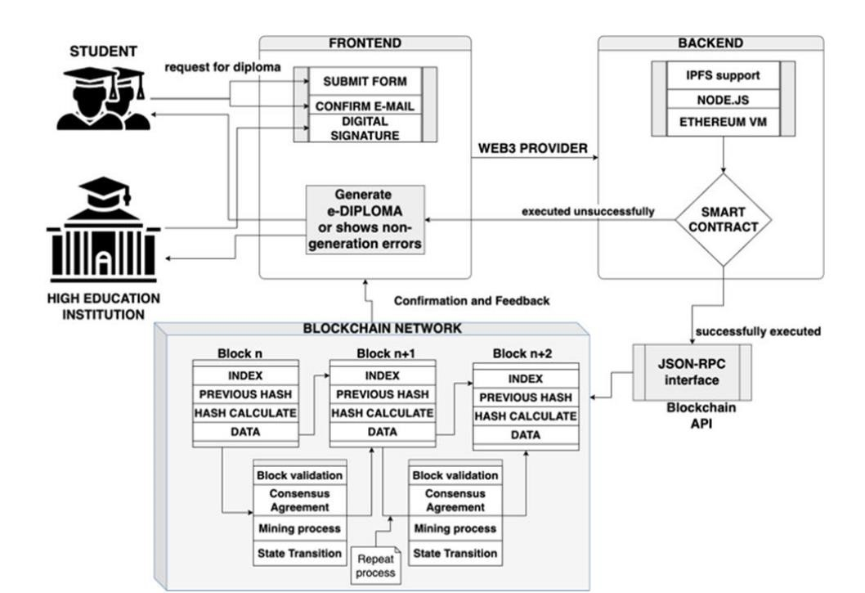
DATAFLOW DIAGRAM

Slide 13
IMPLEMENTATION
Built in Python with PyQt5 GUI – Offers a clean and intuitive interface for users to register and verify certificates.
QR Code integration – Uses the QRCode library to convert hashes into scannable codes for fast and portable verification.

Slide 14
RESULTS
System successfully verifies certificates – Displays "authentic" message when the certificate matches the blockchain hash.
Handles tampered/fake certificates effectively – Any mismatches result in a clear "invalid/tampered" message.

Slide 15
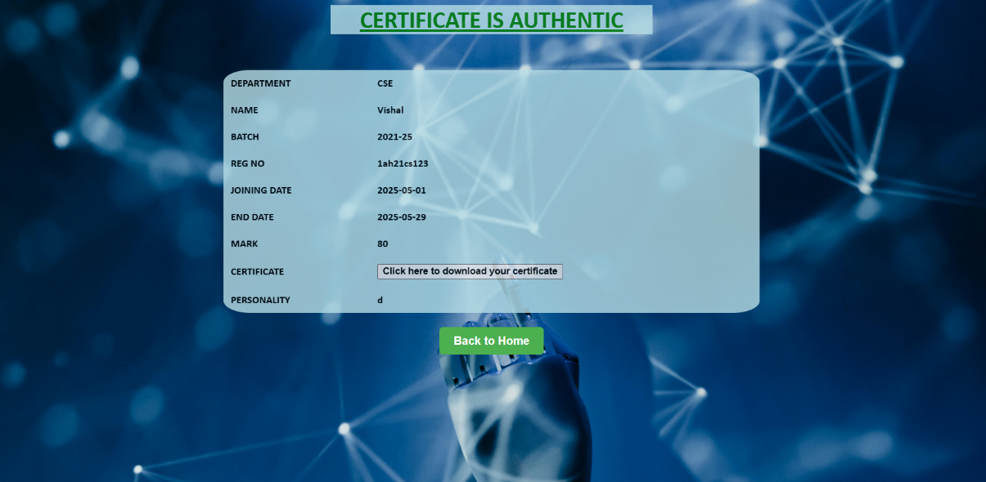

Slide 16
TEST CASES
Unit testing – Verified hash generation, QR output, and blockchain block creation modules individually.
Integration testing – Ensured that GUI, hashing, blockchain, and QR scanning all work together smoothly.
System testing – Checked the full flow from certificate input to final verification under various scenarios.

Slide 17
COMPARATIVE ANALYSIS
Feature | Traditional System | Blockchain-Based System
Tamper Detection | Manual and limited | Cryptographically secured
Verification Time | Several days (manual) | Instant (via QR and hash check)
Dependency on Authority | High (centralized database) | Low (decentralized verification)
Accessibility | Requires human involvement | Fully automated and scalable

Slide 18
CONCLUSION
Blockchain solves trust and efficiency issues – It provides a secure, transparent, and real-time certificate validation mechanism.
Limitations include scalability and adoption – Real-world implementation may face data privacy and mass-scale performance issues.
Future work – Plan to add web/mobile interface, implement identity management, and integrate secure authentication methods.

Slide 19
REFERENCES
D. A. Gayathiri, J. Jayachitra (2022). Certificate Validation Using Blockchain. 7th International Conference on Smart Structures and Systems (ICSSS), pp. 34929–34941.
A. S. P. A. Fouzia, F. Ozair, Nayer Jamshed (2021). Award Badging and Validation Method Using Blockchain. Proceedings of the Second International Conference on Inventive Research in Computing Applications, pp. 315–323.
Min Choi et al. Blockchain-Based Certificate Verification. [Journal/Conference details if available].
Hongning Dai et al. Blockchain Internals and Digital Signatures. Explains block structure, digital signatures, and cryptographic techniques.
Gayatri et al. Digitalization of Certificates Using Blockchain. Proposes hash-based secure storage of academic certificates.
Microsoft & Acclaim (2020). Blockchain-based Certification Badges Platform – Real-world application in issuing digital certificates.

Slide 20
Thank You

